Slide 1
Kerbside Recycling Service Changes
2024 - 2025

Slide 2
Introduction and Background
Carbon neutral by 2030
Council approval in November 2022
Make it easier for people to recycle at home
Improve the quality of material we collect

Slide 3
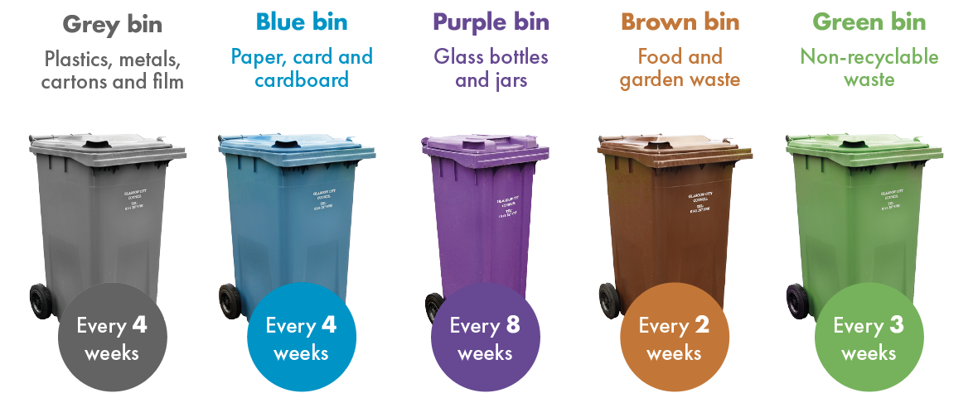
Kerbside Recycling Changes
NEW!
CHANGE!

Slide 4
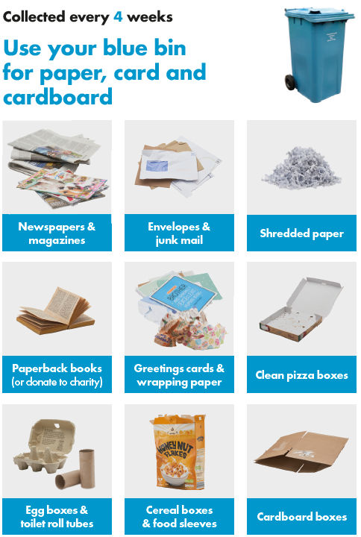
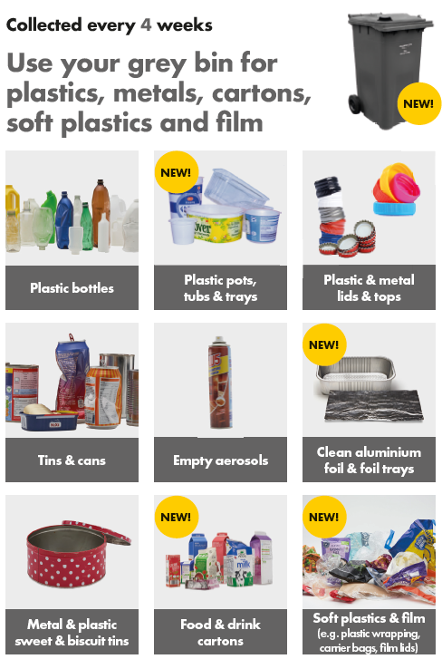

Slide 5
New Collection Service
Blue bin and new grey bin collected every 4 weeks
Same collection vehicle (blue bin vehicle)
Collection day is not changing!

Slide 6
Implementation Plan
Deliveries start in Knightswood area from March 2024
First collection of new bin approx 4 weeks later
Complete all NW area by June 2024
South area from June 2024 – October 2024 (Shieldhall then Polmadie)
North East area from October 2024 – March 2025

Slide 7
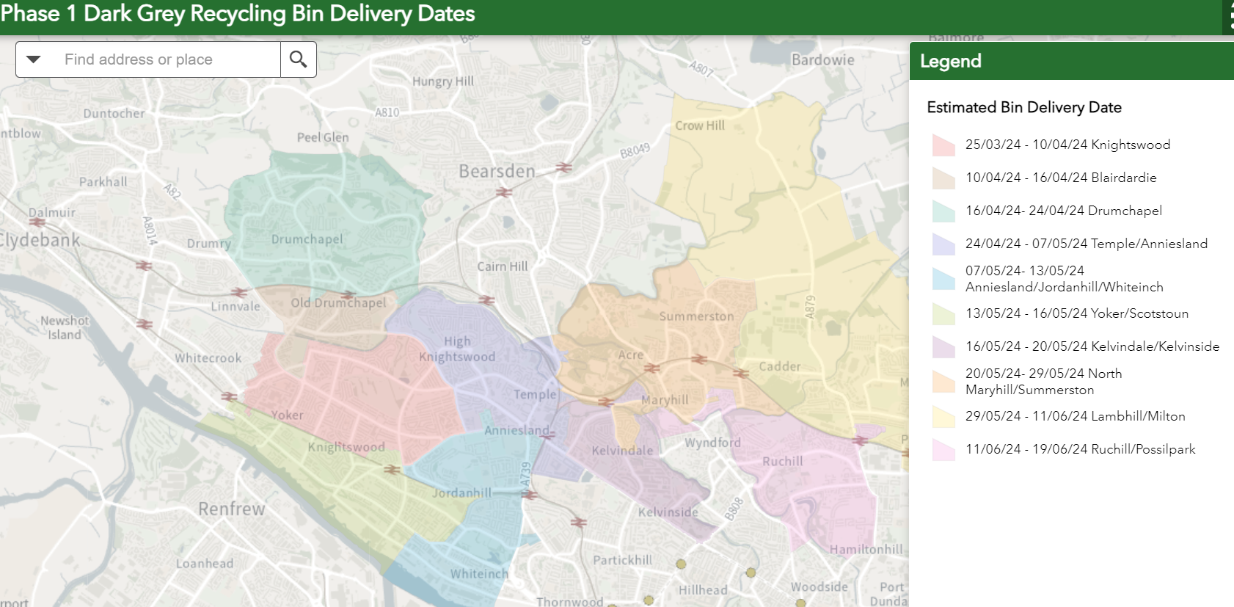
NW Delivery Dates / Areas

Slide 8
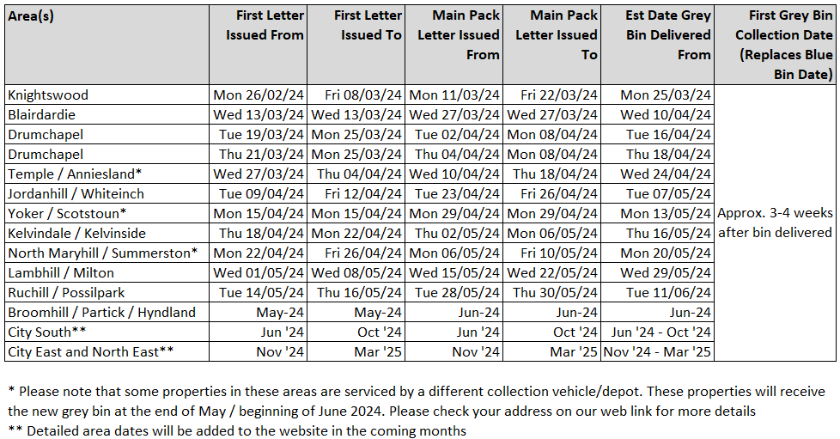
NW Delivery Dates / Areas

Slide 9
How will residents be informed?
Residents will receive a letter approximately 4 weeks before the new grey recycling bin arrives
Information on new service

Slide 10
How will residents be informed?
9pp information pack (recycling guide)
Collection calendar until end of 2025
New stickers for blue bin (x2) and green bin (x1)
Sent 2 weeks after first letter

Slide 11
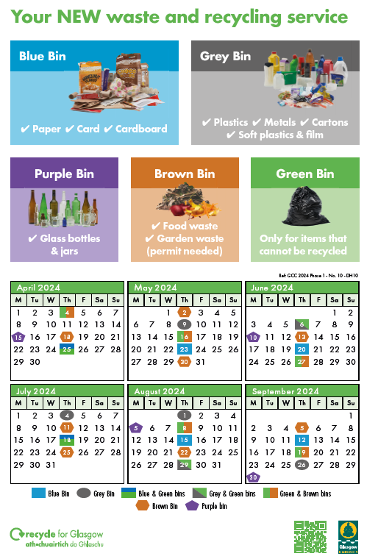
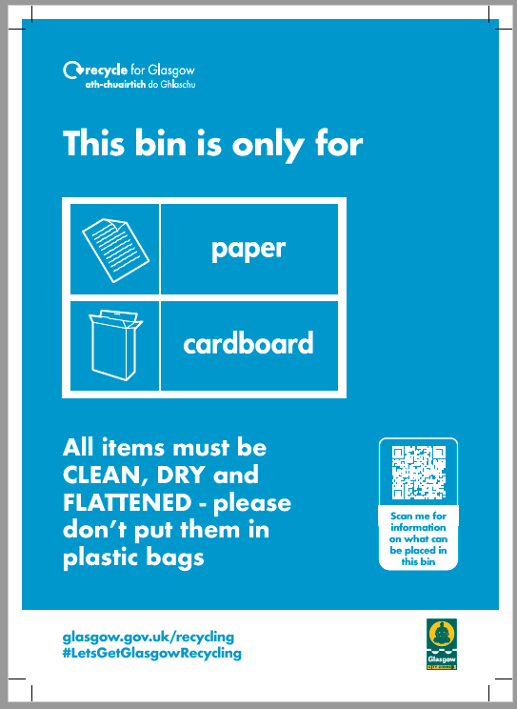
How will residents be informed?

Slide 12
Other Communications and Engagement
Press releases, social media platforms and the council’s website will be used to publicise the changes to the recycling service
Local drop-in events held for residents to learn more about the changes
Web page to check when new bin will be delivered

Slide 13
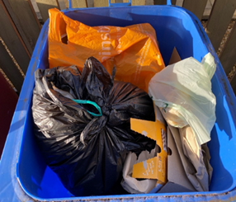
Contamination Policy - Contaminated Bins
Extra cost for GCC to process
Reduces GCC recycling performance
Discourages residents to recycle

Slide 14
New Contamination Policy
4 week collection amnesty after new bin is delivered
After 4 weeks, bin tagged and not collected until material is removed
Uplifted on next collection if contaminated
Frontline staff and supervisor/management training
Investment in frontline service

Slide 15
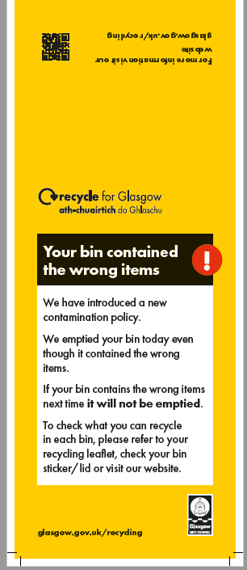
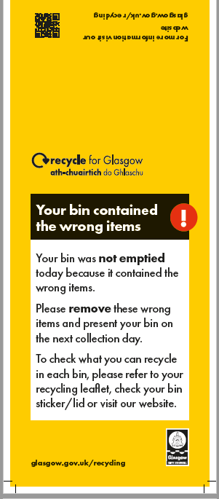
New Contamination Policy – Hangars / Tags

Slide 16
Green Bins – New Policy
Additional green bins adds pressure to depot routes
Extra waste – extra cost for GCC to process
Discourages residents to recycle
New policy - collection of 1 green bin only
Frontline staff and supervisor/management training

Slide 17
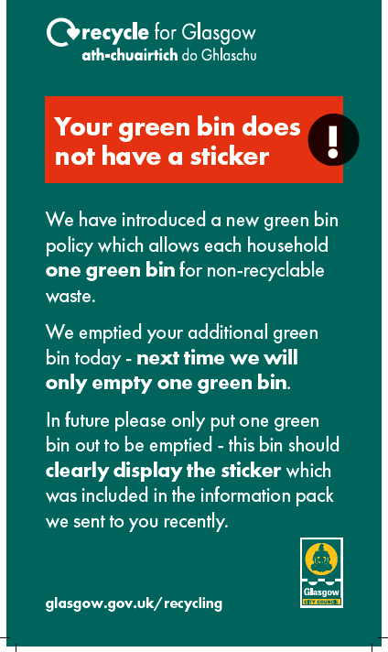
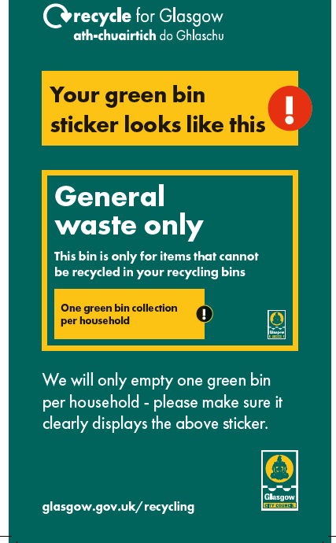
New Green Bin Policy – Hangars / Tags / Sticker

Slide 18
Monitoring and Evaluation
Householder participation rates
Recyclable and non-recyclable tonnage per route
Contamination rates per route
Monitor areas that need further engagement

Slide 19
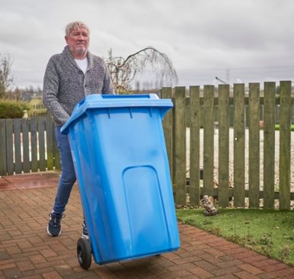
Twin Stream - Next steps
Further engagement
Complete all kerbside properties by March 2025
Expand Bin Hub Pilot
Review Options for Flats

Slide 20
Thank you. Questions?

